Slide 1

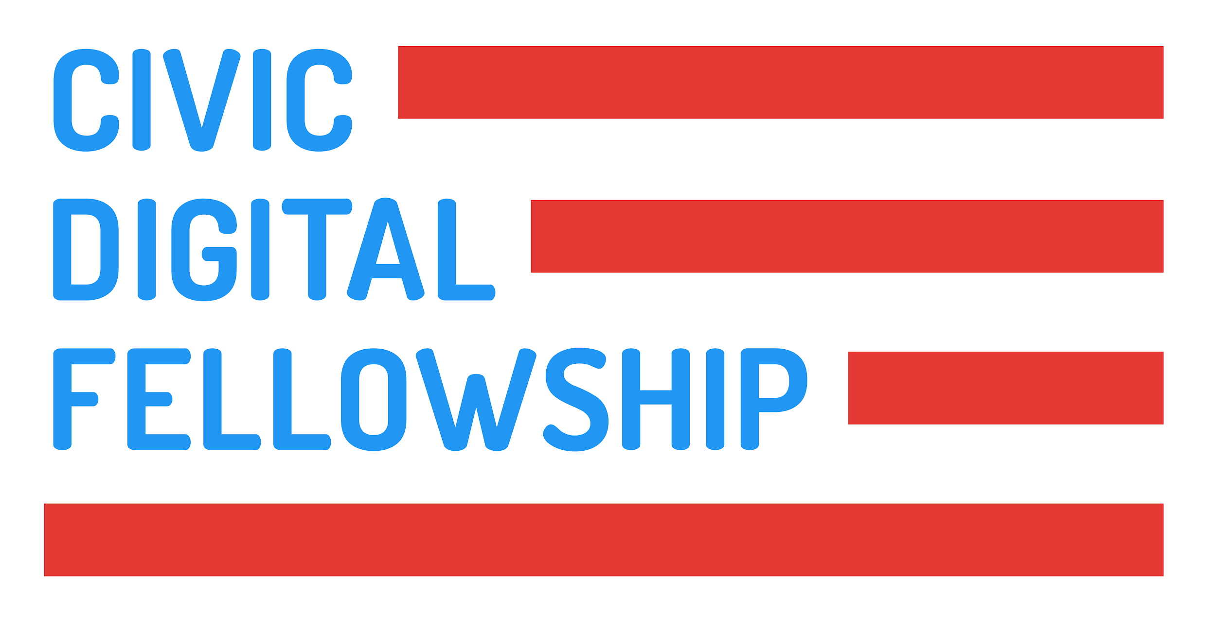

Data Access Committee Reporting Tool
Office of Data Science and Emerging Technology – National Institute of Allergy and Infectious Diseases
Dr. Christopher S Marcum — Staff Scientist
HOYIN CHU
Rachel Dodell
Northeastern University
Computer Science and Mathematics
Notes:
Hello everyone! My name is Hoyin Chu, I am a senior at Northeastern University studying computer science and mathematics. I have been working with the Office of Data Science and Emerging Technology in NIAID and today I will be presenting my project called the Data Access Committee Reporting Tool which I have been working on with my supervisor and mentor Dr. Chris Marcum. And let’s get started!

Slide 2

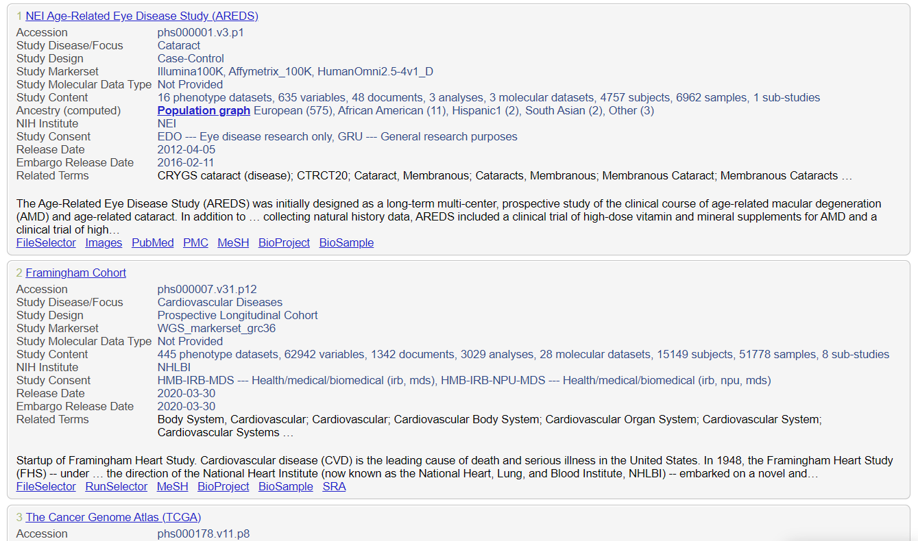
Background
The database of Genotypes and Phenotypes (dbGaP) is a popular database hosting genomic data from institutes across the NIH
Each institute has a Data Access Committee (DAC) which grants approval to data access requests (DAR)
Notes:
To give a little bit of background information, the database of Genotypes and Phenotypes, more commonly known as dbGaP, is a popular database platform hosting genomic data from institutes across the NIH. In order for PI to get access to these data, they will need to submit data access requests, which will be approved by the Data Access Committee that is responsible for the data.

Slide 3
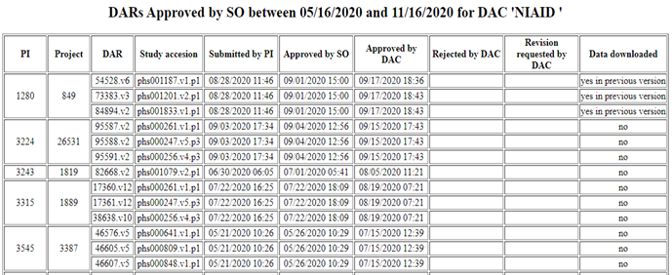
Current workflow
Meta information about DARs are available as a table on a webpage
They can help DACs understand research needs
But it’s difficult to draw insights from just looking at this table
Notes:
So the meta information about these DARs are actually available on a webpage. As you can see from this screenshot, we can see how many DAR a PI has submitted, what study it was for, how it took for the requests to go through, and whether the PI actually downloaded the data. These information can help data access committees understand the research needs, but it’s difficult to draw insights from just looking at this plain table.

Slide 4



My Project
A one-stop-shop R package that can automagically generate a data use report for any DAC using information scraped from the webpage
Notes:
To help DACs better understand their data, I developed a one-stop-shop R package that can automagically generate a data use report for any Data Access Committees using information scraped from the webpage

Slide 5
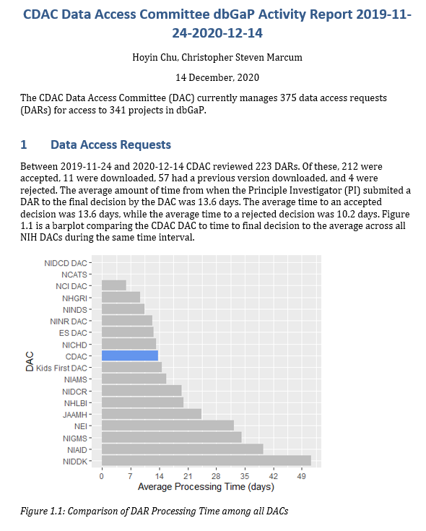
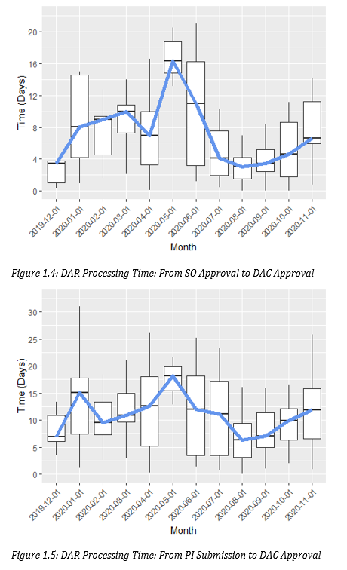
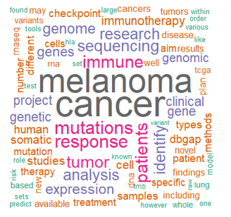
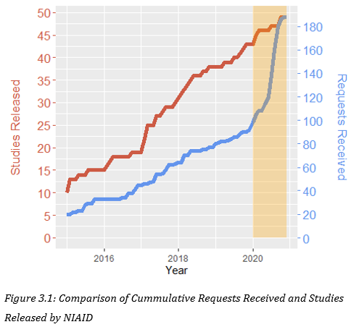
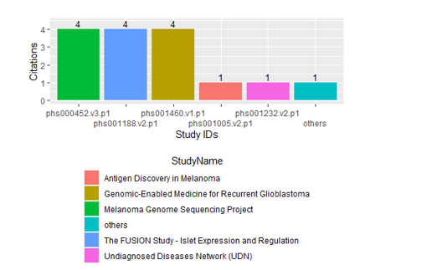
Report
Notes:
Here is a showcase of what the report contains. For example, we have section comparing how long it takes for a data access request to get approved on average between institutes, a month by month boxplot showing how it takes for a data access request to go through each step of the approval process. We also have wordcloud visualization of the most commonly mentioned terms for a particular study, a trend comparison between the number of studies released versus the number of data access requests received. We also scrape data from google scholar to see which study received the most citation over a period of time.

Slide 6
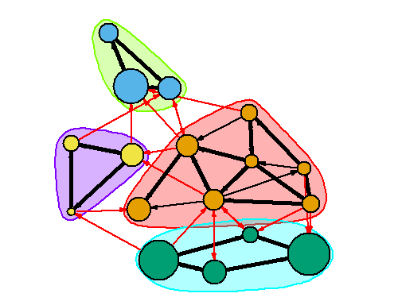
Future Work
These data can help us answer more complicated research questions
Examples: Study-to-Study Network
What are some unexpected communities?
How do these networks evolve over time?
Notes:
These data can actually help us answer more complicated research question. For example, a functionality that is in development is to construct a network where studies are the nodes, and two studies are connected if they have been requested by the same PI. Similarly, we can also construct a network where PI are the nodes, and two PI are connected if they requested the same study. By constructing these networks, we can find unexpected communities, and by looking at how these networks evolve over time, we can have a better understanding of the research landscape.

Slide 7
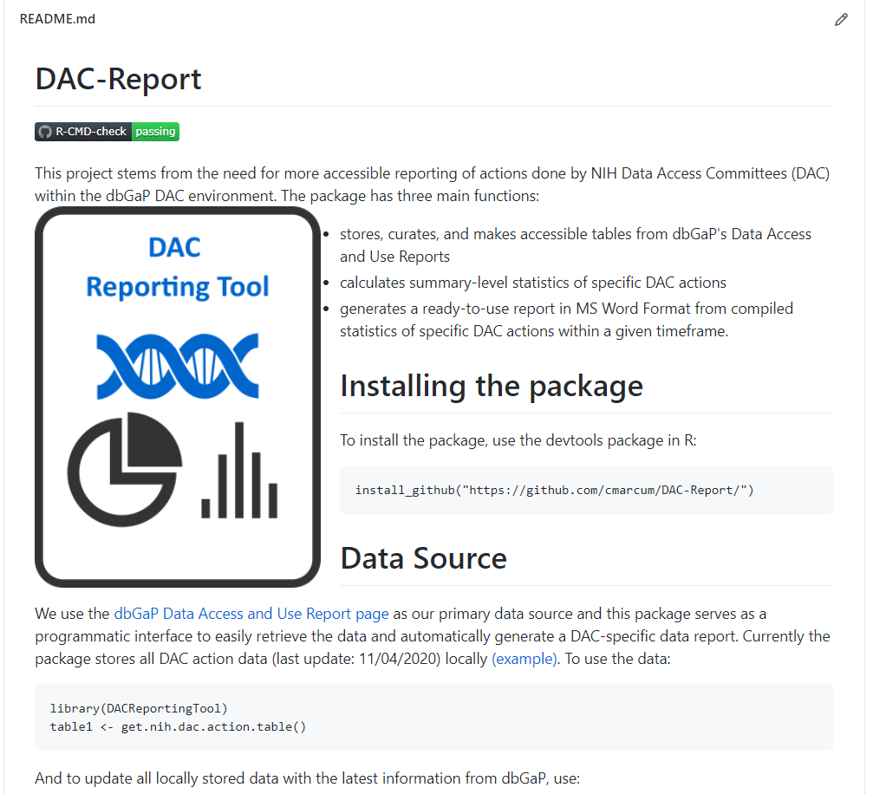
A Starting Point
Open-source practices (version control, continuous integration, documentation…) were followed during the development of the package
Package will be available to the public and features can be added via pull requests
Notes:
While developing the project, we followed open-source practices such as version control, continuous integration and documentation, which means after the fellowship is over, people can add new feature to it by simply making a pull request. This package is also public so feel free to play around and see what data analysis or machine learning things you can do with it!

Slide 8
Thank you!
ODSET (Office of Data Science and Emerging Technology) Team
Emerging Leaders in Data Science Fellows
Everyone who made the fellowship possible
Notes:
Lastly, I just want to thank the Office of Data Science and Emerging Technology Team and the Emerging Leaders in Data Science Fellows for all the helpful the advices they have gave to me, my experience wouldn’t have been the same without them and I have learned a lot from them. And thank you to everyone who made this fellowship possible.

Slide 9
References
Icons: thenounproject
Network Image: https://kateto.net/network-visualization

